Slide 1
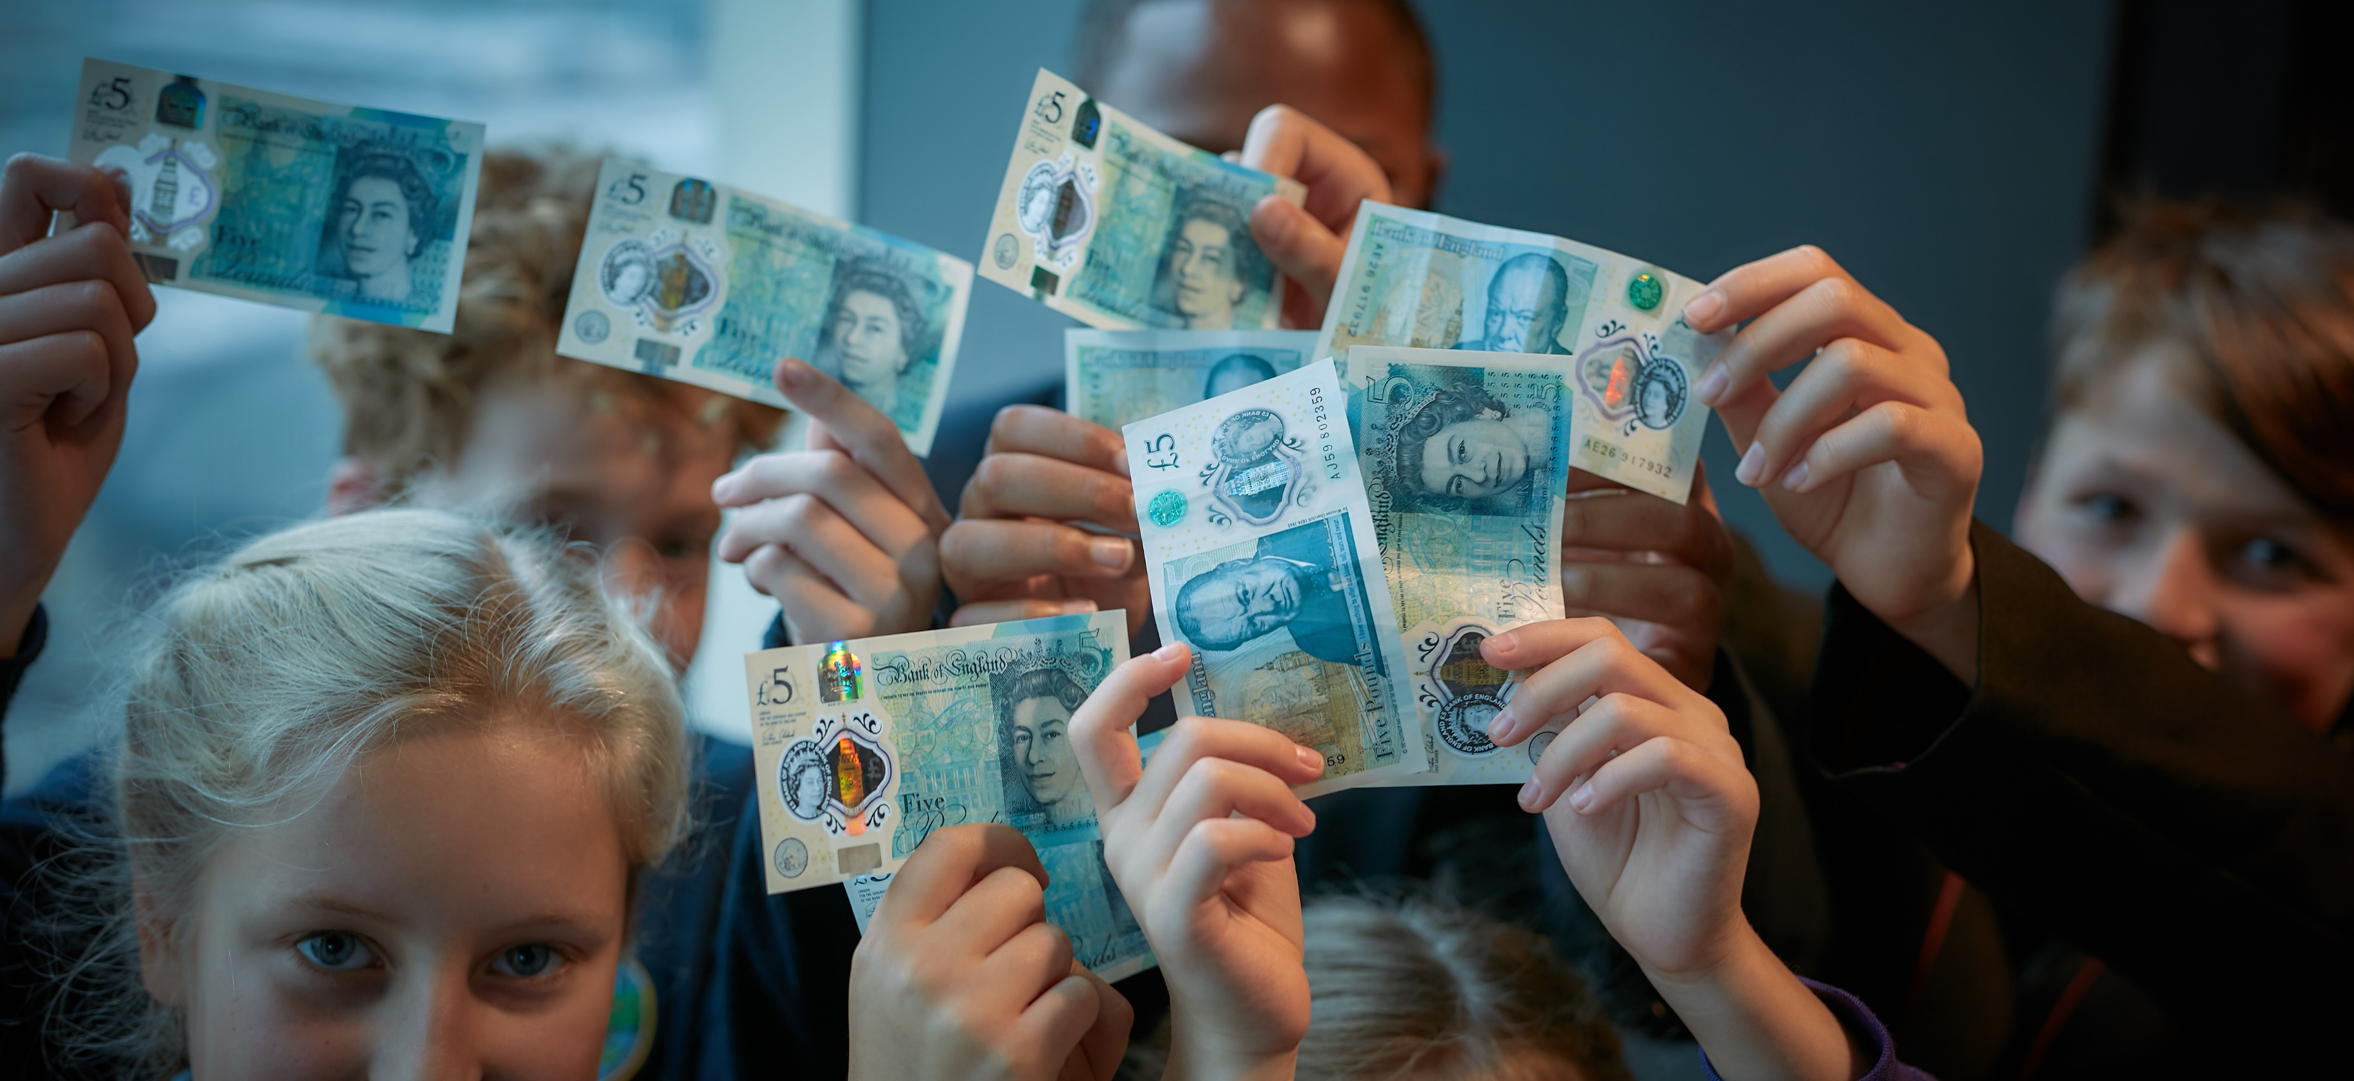
WEEK 1
Fiver Challenge
Notes:
Teacher Notes
Week 1:
This PowerPoint presentation provides…
A reminder of the tasks the pupils will need to think about and complete that week, together with a list of resources that will help them.
An activity that is linked to the tasks for that week to help them to succeed.
Note: Depending on how much time you have in advance of the challenge you may want to do some of the introductory activities earlier.

Slide 2
Products & Services
Have you ever thought of something that would be really good to do or to make?
Usually when we do something for someone, and charge them money for it, we call it a service.
When we make something and sell it, we call it a product.
Top Tip: Whilst listening, writing down key information in your workbook can help you when creating your ideas.
Notes:
Teacher Notes
Activity 1 (5 minutes)
To start them off, this activity is designed to enable them to understand:
The difference between a product and a service.
Different types of products and services.
How we can consider the social good our ideas achieve.
What we mean by sustainable and whether our ideas are sustainable.
The next slide explores what we mean by ‘sustainability’ in a business context.
Skills Builder Essential Skills
Listening - Step 5: I listen to others and record important information as I do
Listening is the skill of receiving, retaining and processing information. Encourage students across the challenge to use their workbook and jot down relevant notes and ideas as they listen. This will help them when they are coming up with their product or service and they might gather information from the great examples in the slides.
To incorporate the essential skill, provide the following tip when covering this slide:
Whilst listening, writing down key information in your workbook can help you when creating your ideas.

Slide 3
Sustainable Business
In the Fiver Challenge, we encourage a sustainable approach to business.
What does sustainability in business mean?
Protects the planet (e.g. reduces air miles by using local resources).
Cares for communities (e.g. pays a fair price to suppliers).
Profitable and aims to satisfy a need.
“A business which operates today in a way that values and protects the people, planet and resources it relies on for the future.”
Big changes start small.
Think: What information would be useful to
write down?
Notes:
Teacher Notes
Activity 1 Continued…
All businesses, big and small, have to think about the way they make a product or sell a service and if it is sustainable. It is not just about how much money they can make (profit).
Whilst profit is an important aspect of running a business, as it will allow you to grow if you invest the money properly, there are other key aspects to consider.
In the mid-1990s, John Elkington produced a new way of measuring business results--the 'triple bottom line'. Going beyond profit, this includes environmental and social impacts. It is sometimes known as "People, Planet, Profit".
One way a Fiver business could achieve this is by spending time researching suppliers who operate as sustainably as possible. Another would be to make sure to use eco-friendly packaging to reduce plastic consumption and non-biodegradable waste.
You can tell the pupils that they will need to think about all these things once they start to plan in Week 1. You can direct them towards the ‘Top Tips for Sustainability’ sheet.
Skills Builder Essential Skills
Listening - Step 5: I listen to others and record important information as I do
To incorporate the essential skill, ask the following reflective question when covering this slide:
Which information would be useful to write down?

Slide 4
United Nations SDGs (Sustainable Development Goals)
Notes:
Teacher Notes
Activity 1 Continued…
The Sustainable Development Goals (SDGs), also known as The Global Goals, are a shared agenda to end poverty, fight inequality & injustice and protect the planet. Agreed in 2015 by all countries within UN and set to be completed by 2030.
If your pupils do have a clear sustainability focus for their Fiver businesses, they could be in with a chance of winning the ‘Best in Sustainability’ prize for the National Competition!

Slide 5
Product or Service?
Dog Walking
Clothes Swap Shop
Decorating T-Shirts
Making Eco-Friendly Products
Making Jewellery and Keyrings
Sports Tournaments
Upcycling Products
Greetings Cards
Food Service
Notes:
Teacher Notes
Activity 1 Continued…
Each product and service appears on one mouse click. Ask the pupils to shout out or raise their hands to say if it is a product or a service and why.
If they are confused or don’t know you can explain what they are.
Ask the pupils if they think these are good ideas.
Encourage them to start thinking of their own ideas.
A: Services
Dog Walking
Clothes Swap Shop
Sports Tournaments
Food Service
A: Products
Greetings Cards
Upcycling Products
Decorating T-Shirts
Making Eco-Friendly Products (e.g. bookmarks, soap, pots etc.)
Making Jewellery and Keyrings

Slide 6
Here’s £5!
The first thing to do is get into your teams for the Fiver Challenge and decide what product or service you are going to offer.
There are no bad ideas!
Use your Workbook to help you record your ideas. Write or draw whatever you come up with.
Discuss: Why is it important to have a positive attitude when dealing with challenges during this project?
Notes:
Teacher Notes
You can remind the pupils of the ideas you have just talked about. In their teams, or alone if they are working independently, ask them to think about and record their own ideas. Then encourage them to decide which idea they want to use.
Firstly, they’ll need to think of what they will be selling – will it be a product or service? They must make sure that the business they create is in the rules of the Fiver Challenge (Teachers please refer to the Terms and Conditions).
Skills Builder Essential Skills
Aiming High - Step 4: I work with a positive approach to new challenges.
Aiming High is the ability to set clear, tangible goals and devise a robust route to achieving them. Explain to students that they will undoubtedly encounter challenges across the project but that it’s important to have a positive attitude to new challenges. Students could talk about why they think it is necessary to do this.
To incorporate the essential skill, ask the following reflective question when covering this slide:
Why is it important to have a positive attitude when dealing with challenges during this project?

Slide 7
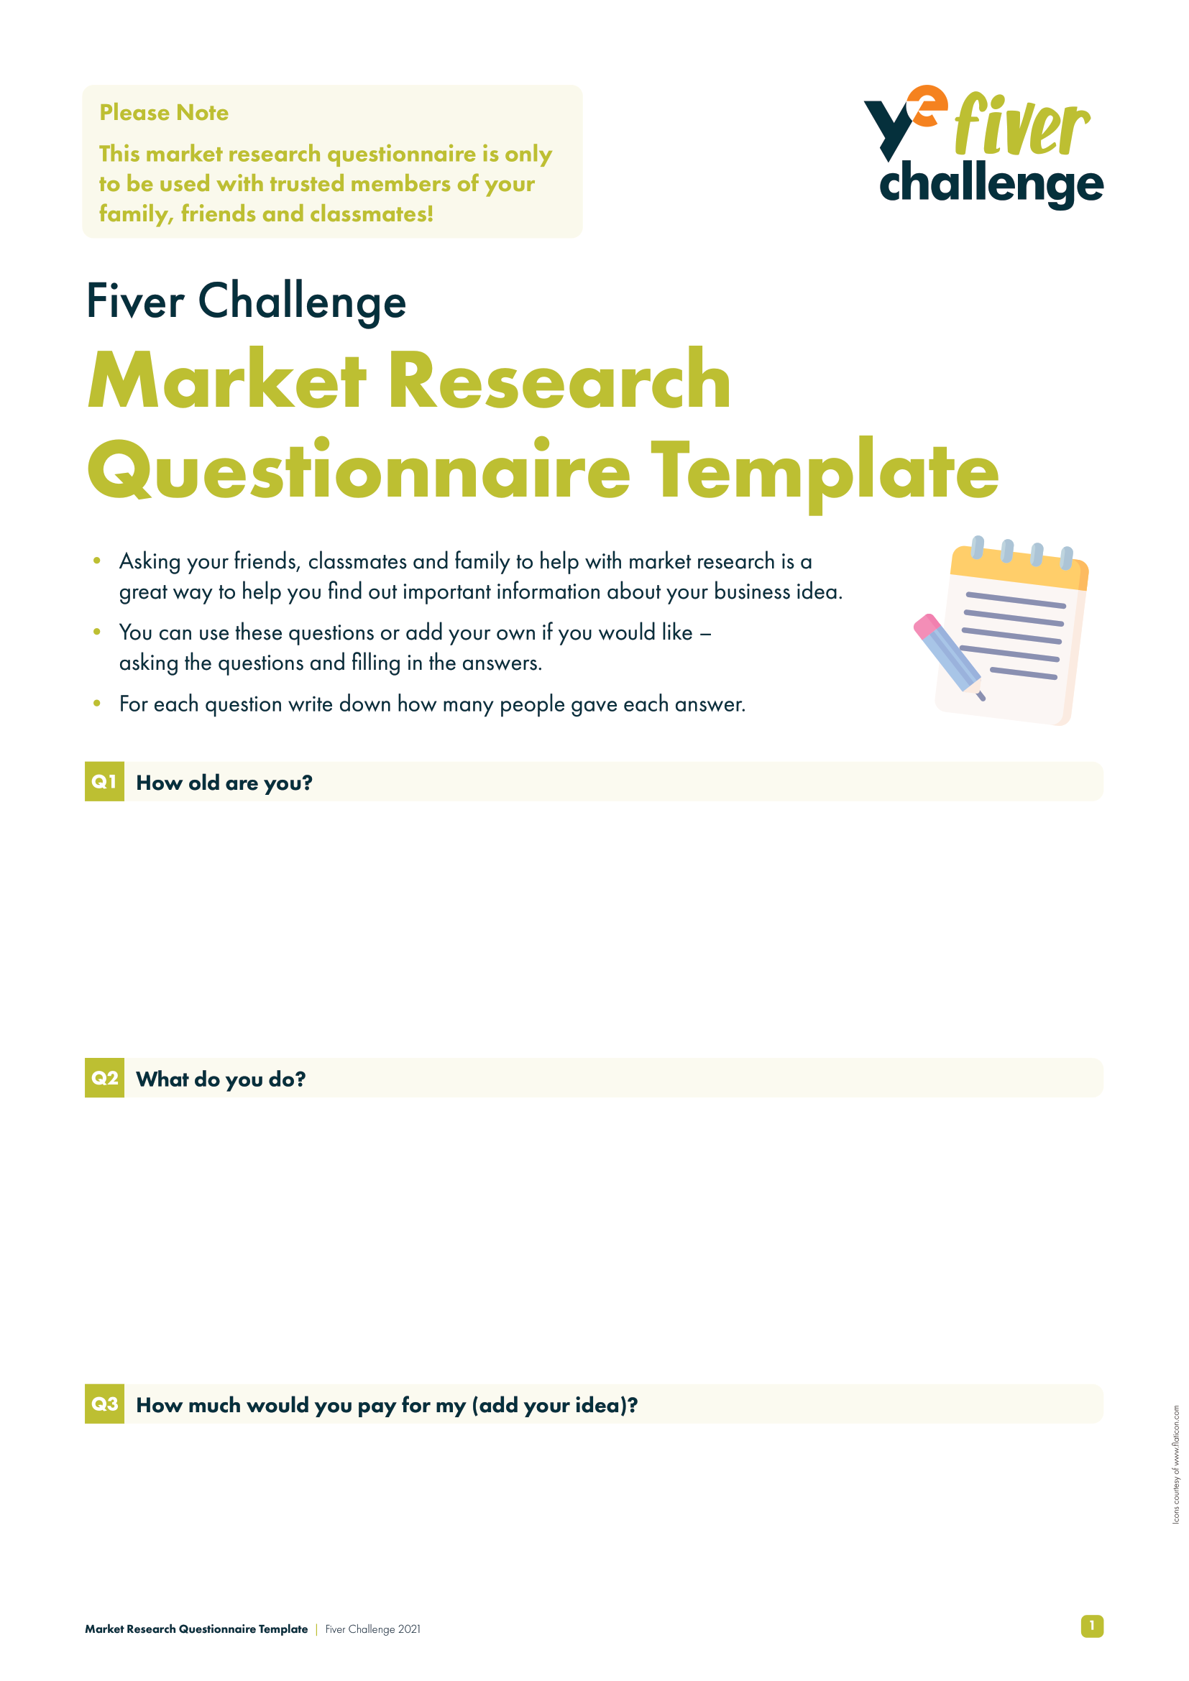
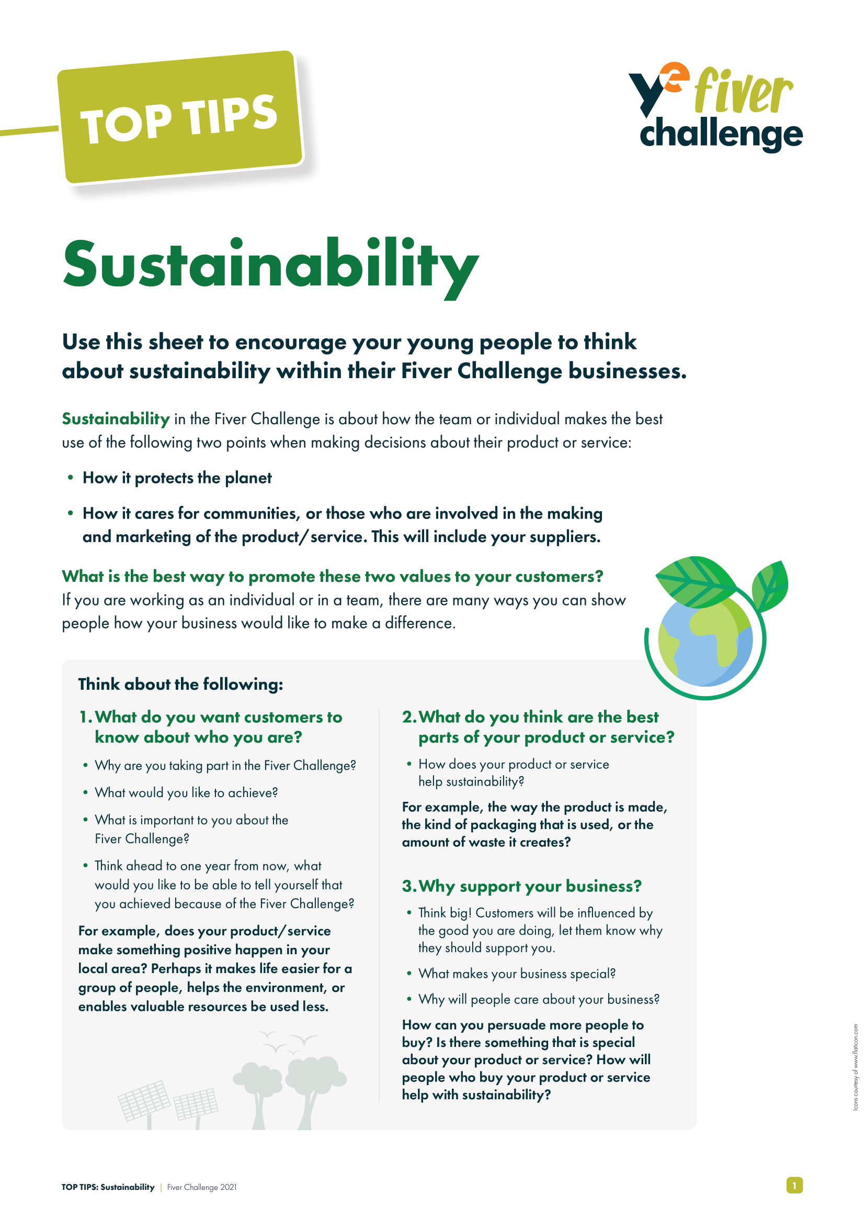
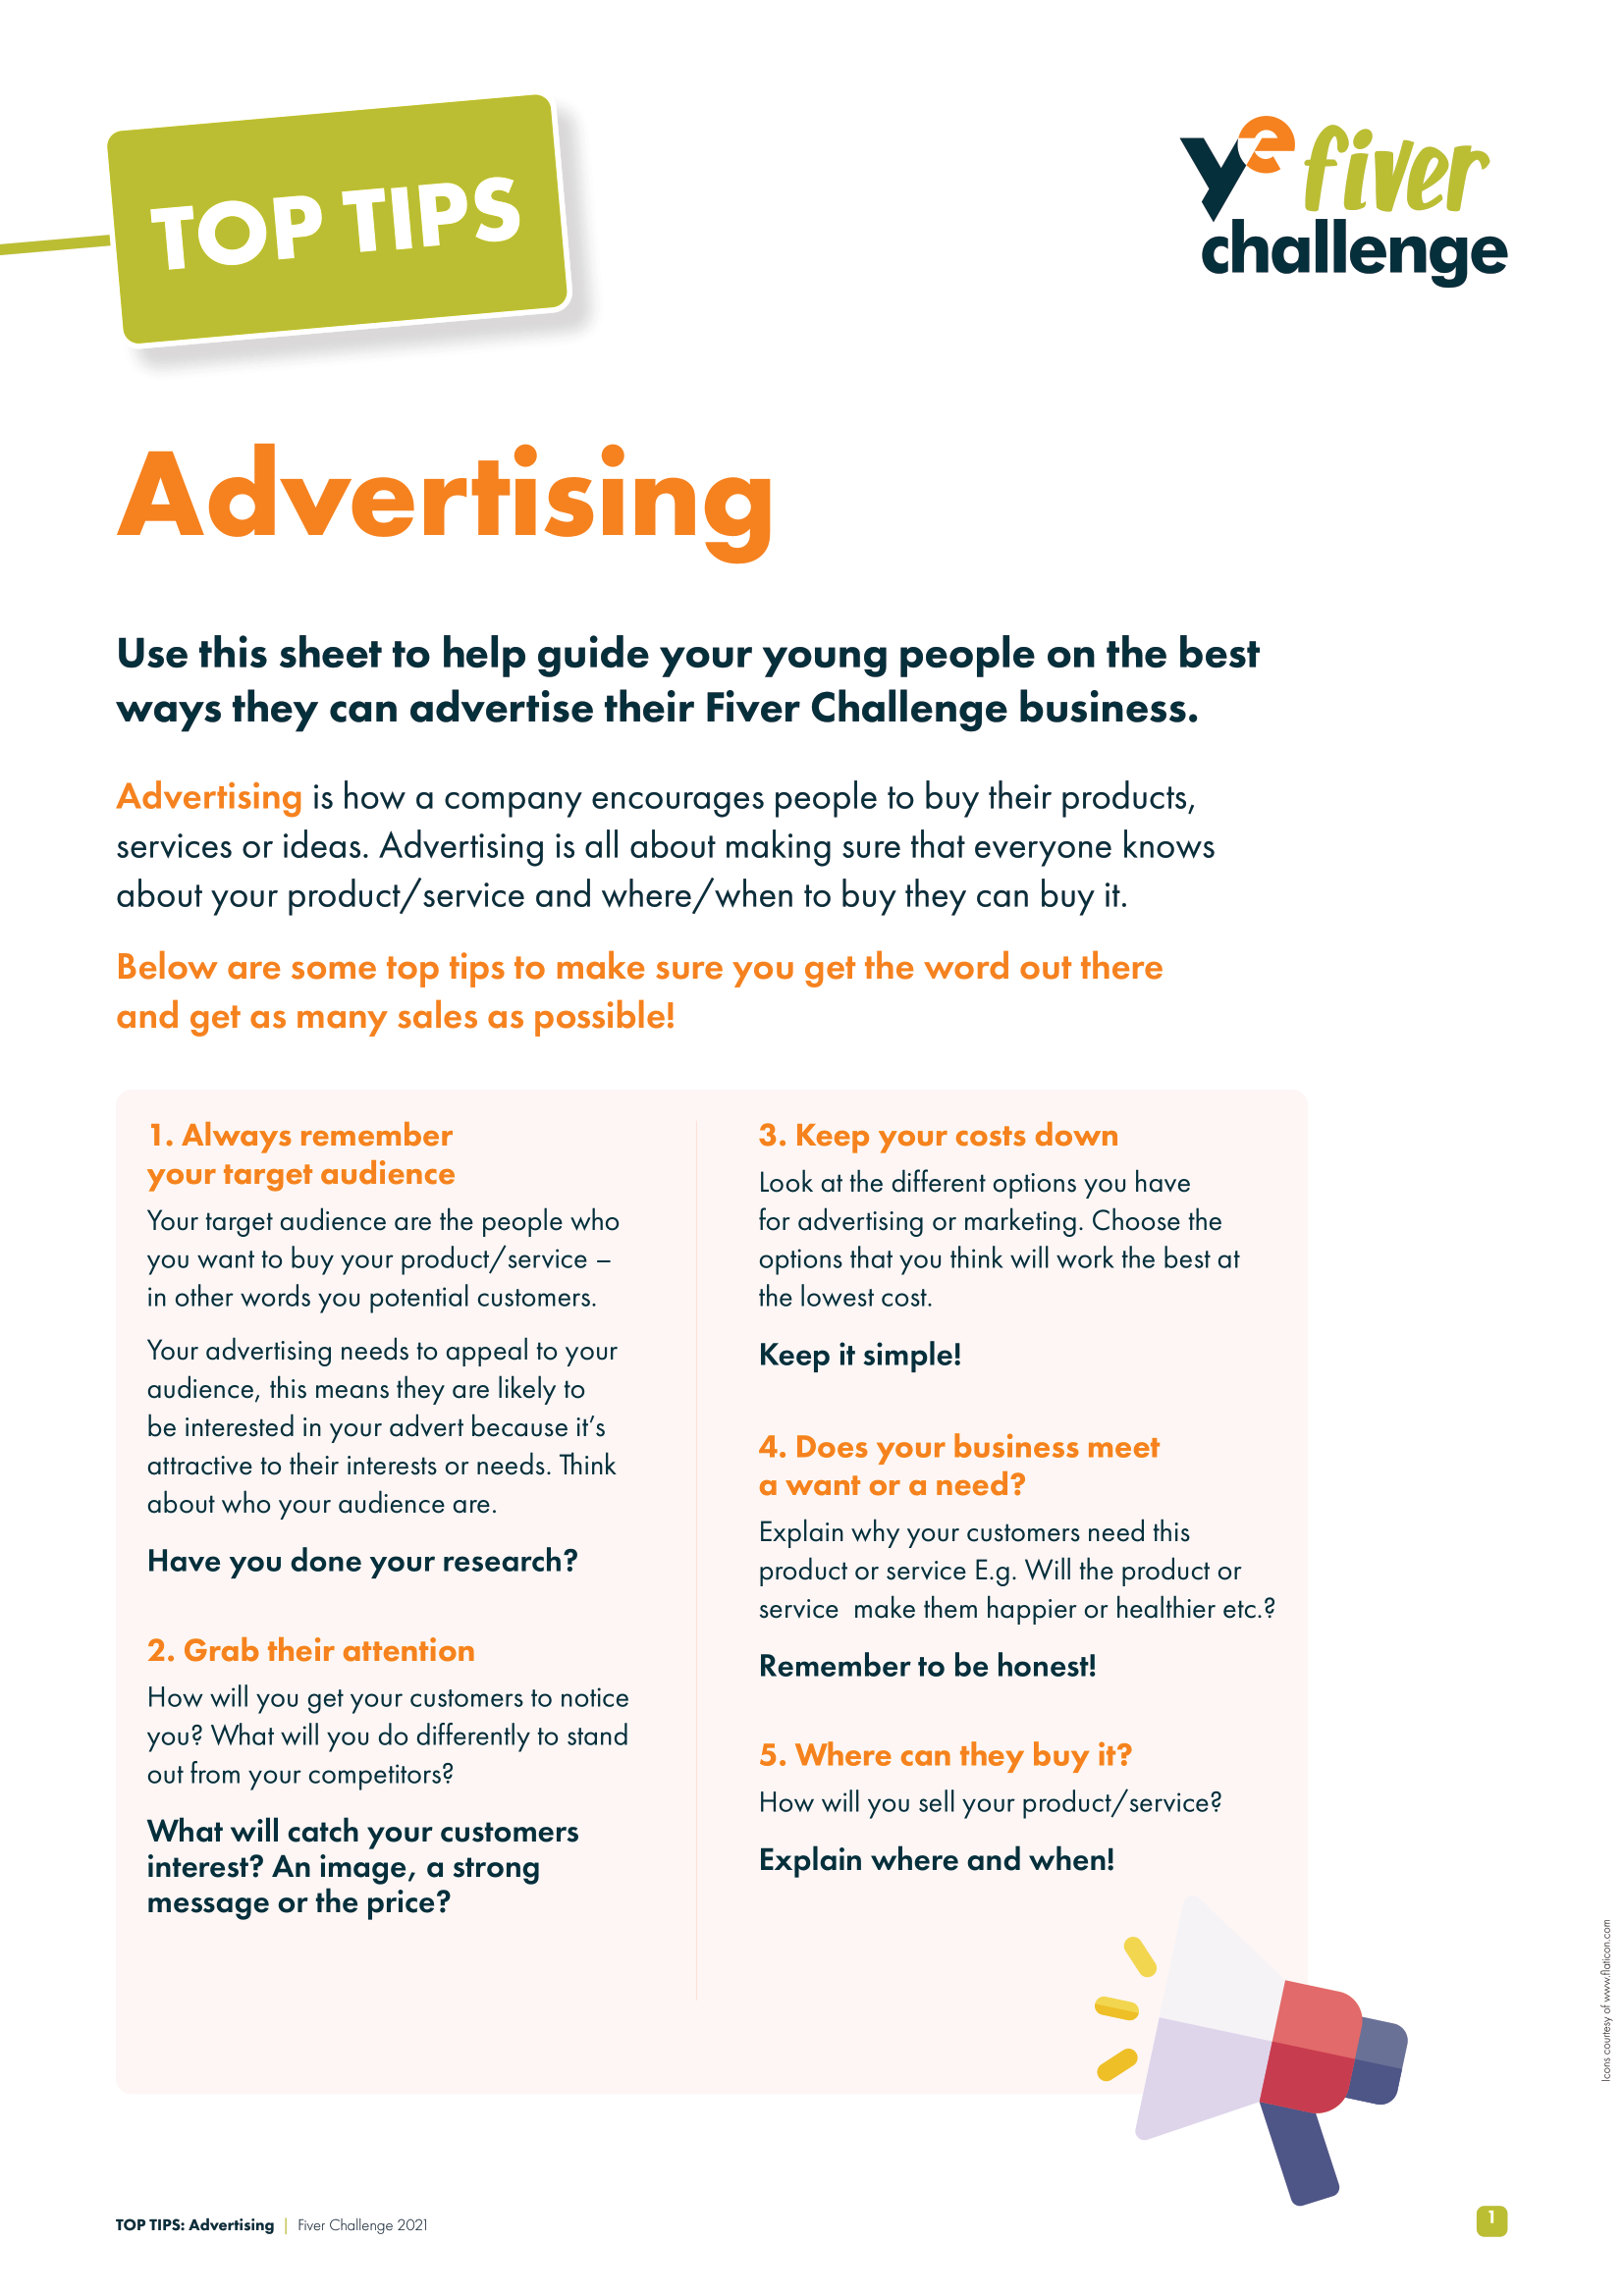
Here’s £5!
You will need:
Fiver Challenge Workbook
Market Research Questionnaire Template
Top Tips for Sustainability
Top Tips for Advertising
Notes:
Teacher Notes
This slide maps out what resources are available to pupils during Week 1.

Slide 8
Here’s £5!
What you need to do:
Decide on your product or service.
Think about your business name and logo.
Do some market research to test out your ideas.
Agree which idea you like best.
Think about the design of your product or service.
Collect your £5.
Enter the Logo Competition!
Think: How can you support your team members, and
why is this important for the challenge?
Notes:
Teacher Notes
Following the available resources for Week 1, this slide maps out what specifically pupils will need to do during Week 1.
Skills Builder Essential Skills
Teamwork - Step 4: I work well with others by supporting them if I can do so.
Teamwork is the skill of working cooperatively with others towards achieving a shared goal. Explain that across the challenge students will need to support each other and discuss what this might look like and why it is important. Students could identify situations for this week’s task where they think they will need to support others.
To incorporate the essential skill, ask the following reflective question when covering this slide:
How can you support your team members, and why is this important for the challenge?

Slide 9
Choosing Your Fiver Business
Product
Maybe hand-made or home-grown? Personalised?
Can you link it to a topic or theme, event or local opportunity?
Service
Using your team to create/offer an activity for a fee?
Examples include car-washing or dog-washing.
How can you make sure you profit from your £5?
Notes:
Teacher Notes
This slide is intended to summarise ideas for the pupils before moving forward.
Skills Builder Essential Skills
Teamwork - Step 4: I work well with others by supporting them if I can do so.
To incorporate the essential skill, ask the following reflective question when covering this slide:
What does it mean to support other people?

Slide 10
How Do You Recognise a Logo?
YouTube
Nike
PlayStation
Notes:
Teacher Notes
Activity 2 (5 minutes)
Every business needs to stand out to attract customers.
Each product and service appears on one mouse click.
Ask the pupils to shout out or raise their hands if they identify the logo before revealing the brand name.
YouTube
The graphic image of the video playback button is a symbolic display of the essence of the largest American video hosting platform.
Nike
Nike co-founder Phil Knight was adamant that his company's new logo be a simple design that is fluid and conveys motion and speed. The logo is also said to symbolize the wing of the Greek goddess of victory, Nike.
PlayStation
The PlayStation logo was designed by Manabu Sakamoto. He wanted the logo to capture the 3D support of the console, but instead of just adding apparent depth to the letters "P" and "S", he created an optical illusion that suggested the letters in depth of space.

Slide 11
Your Business Name and Logo
What does your business name and logo say about your business?
Think about your use of colour, shape and words.
What about a picture? What would it represent?
What about your name or initials?
What about inventing new words and making rhymes?
Identify other information that would help you with
your business name and logo.
Notes:
Teacher Notes
Introduce…
Colour Theory, specifically in terms of how certain colours make us feel and what we associated them with (e.g. blue is a calming colour, green relates to nature and growth, and red is associated with danger, but also strength). Find out more: https://www.colorpsychology.org/
Generally, it’s a case of fewer words, the better. One or two words are preferable over long sentences (Nike, YouTube, and PlayStation are good examples from the previous slide).
Shapes and pictures can suggest different meanings (e.g. a padlock suggests security or safety, a tree suggests growth, hands suggest support and togetherness etc.). Pictures can be strong symbols of things we value, such as quality, value and security.
Examples:
H&M: Initial only - Hennes and Mauritz. Hennes is Swedish for ‘hers’ and Mauritz is the owner.
Heinz: Beanz, Meanz Heinz is a rhyme used for marketing to make their brand memorable.
Play with combinations of your choice of words by mixing them up! Netflix, for example, is short for ‘internet’ and ‘flix’ (an alternative word for cinema).
Skills Builder Essential Skills
Problem Solving - Step 3: I complete tasks by finding information I need myself.
Problem solving is the ability to find a solution to a situation or challenge. Talk to students about further information they might need to find out when thinking about their branding. Do they need further examples? Do they want to look at what similar products or services have done? Get them to think about where they might find that information.
To incorporate the essential skill, ask the following reflective question when covering this slide:
Identify other information that would help you with your business name and logo.

Slide 12
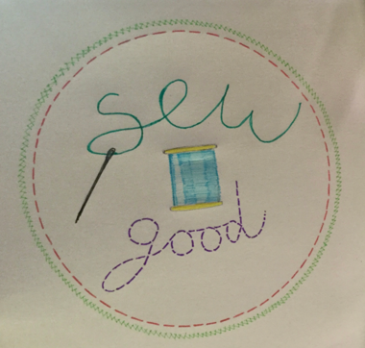
Fiver Logo Winner
Why do you think this logo previously won the Fiver Challenge logo competition?
Think: Before you give your answer, take time to consider how you will explain your thoughts.
Notes:
Teacher Notes:
Ask the pupils why they think this was a logo winner? Then explain if needed:
Sew = ‘So’ (i.e. ‘really’)
Good = Good product/good for the environment
The visual representation of the needle and stitches makes the logo eye catching and relates to the business idea.
They sew a product, and it is really (so) good for the environment.
Skills Builder Essential Skills
Speaking - Step 3: I speak effectively by making points in a logical order
Speaking is the oral transmission of information or ideas. When students are speaking to the room, it is important they know that a logical order is putting ideas in an order that means they make sense when they follow on from each other. Encourage them to think about how they’re going to explain their points before feeding back.
To incorporate the essential skill, ask the following reflective question when covering this slide:
Before you give your answer, take time to consider how you will explain your thoughts.

Slide 13
What’s in a Name?
Now it’s your turn.
Remember, it’s important to choose a name and logo…
That represents what the business does.
That is memorable.
That is unique (we don’t want copyright or brand infringements!).
Think: Why is it important to be willing to take on new challenges? How do you know if your ideas are successful?
Notes:
Teacher Notes
Focus the pupils on their business name and logo, using their Fiver Challenge Workbook to guide them.
Remind the pupils that they can enter the Logo Competition. The deadline for submission is the Sunday at the end of Week 1 (check the Fiver website for the exact date).
Skills Builder Essential Skills
Aiming High - Step 4: I work with a positive approach to new challenges.
To incorporate the essential skill, ask the following reflective question when covering this slide:
Why is it important to be willing to take on new challenges?
Creativity - Step 3: I generate ideas when I've been given a clear brief
Creativity is the use of imagination and the generation of new ideas. To help us to generate ideas we are sometimes provided with a brief. A brief is a problem or challenge that we have to come up with ideas to solve. The brief might be short or long; it might be in a written form, or it might be spoken.
To incorporate the essential skill, ask the following reflective question when covering this slide:
How do you know if your ideas are successful?

Slide 14
Your Market Research
When starting a business, researching the market is very important. It can help you find out information about your customers, competitors and your business.
Using your Fiver Challenge Workbook to guide you and the Market Research Questionnaire Template you can now test out your idea, your business name and logo on people to find it if it works.
Be prepared, you may need to make some changes depending on what people say.
Think: How do we know what information we need? What are some of the key questions that you should include about your ideas?
Notes:
Teacher Notes
As children will now have thought about their company name and logo, they can test that out on potential customers. Guide them to prepare their market research using their workbook and the template provided, if that helps.
Skills Builder Essential Skills
Problem Solving - Step 3: I complete tasks by finding information I need myself.
To incorporate the essential skill, ask the following reflective question when covering this slide:
How do we know what information we need?
Creativity - Step 3: I generate ideas when I've been given a clear brief
To incorporate the essential skill, ask the following reflective question when covering this slide:
What are some of the key questions that you should include about your ideas?

Slide 15
Week 1 Recap
You have collected your £5.
You selected your product or service.
You have a business name and logo.
You have done your market research.
You may have a product or service design.
You have entered the Logo Competition.
You have developed your essential skills.
Notes:
Teacher Notes
This slide reminds pupils of what they have achieved at the end of Week 1!

Slide 16
COMPLETE
Well done, you have completed Week 1!

